Slide 1
BUILD MY PORTFOLIO
WEBSITE
Saravanan. N,
Front end-developer.

Slide 2
INTRODUCTION:
Hello and welcome!
Portfolio is like a long resume about yourself, As a FRONT END DEVELOPER everyone wants to have a portfolio, As a part of hands on learning experience. Now we are going to see about how to build a portfolio.

Slide 3
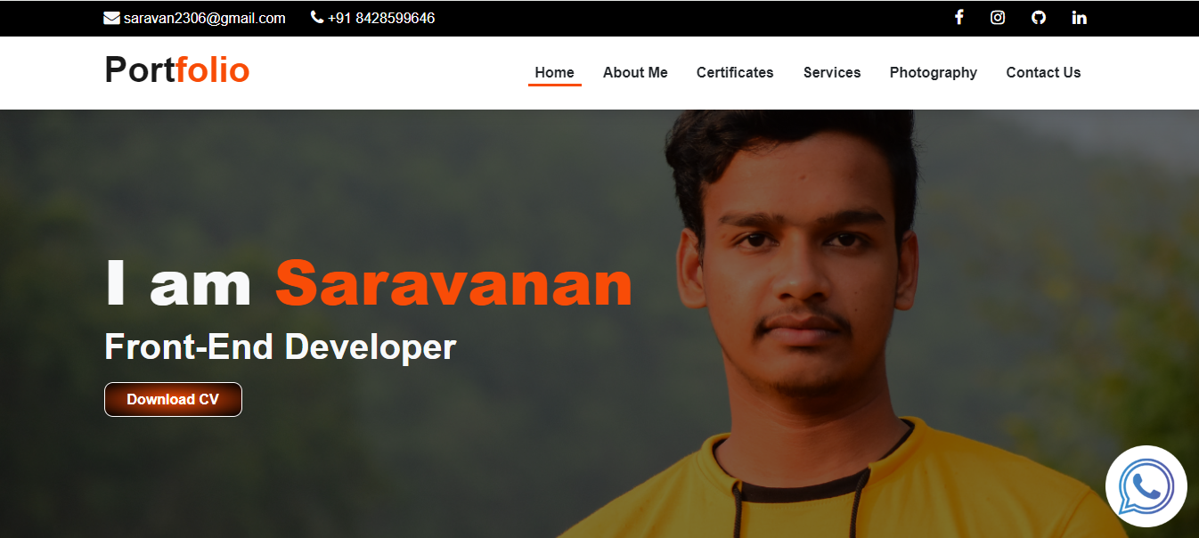
HOME PAGE:

Slide 4
IMPORTANCE:
It is very important to design our own portfolio to stand unique among the crowd and it helps us to be creative and learn more new things from the portfolio that we are making. Designed and developed a responsive website using HTML, CSS, Bootstrap, JavaScript and React JS.

Slide 5
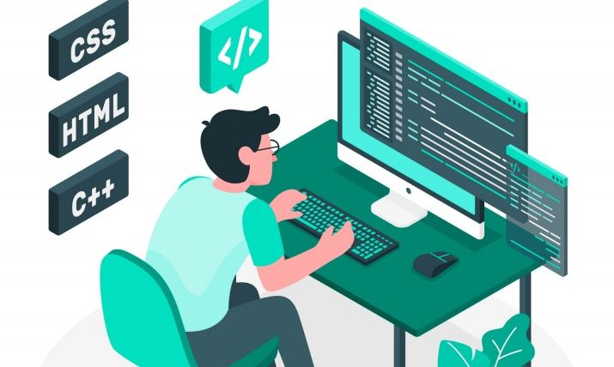
WHAT WE’LL COVER:
1. Design Aesthetics
2. Content Strategy
3. Technical Implementation

Slide 6
ROADMAP:
1. Planning Phase: Define the website's purpose, target audience, and key features.
2. Design & Development: Create wireframes, choose a design theme, and start building.
3. Content Creation: Develop engaging content, including project showcases, bio, and contact information.

Slide 7
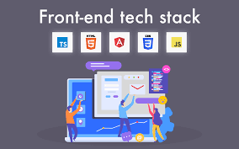
USING TECHNOLOGIES:
HTML
CSS
Bootstrap
JavaScript

Slide 8
SUCCESS METRICS:
1. Professional Presence: A polished and modern online space that reflects Saravanan's professional identity.
2. User Engagement: A website that captivates visitors, encouraging them to explore various sections.
3. Functional & Responsive: Ensuring the website works seamlessly across different devices.

Slide 9
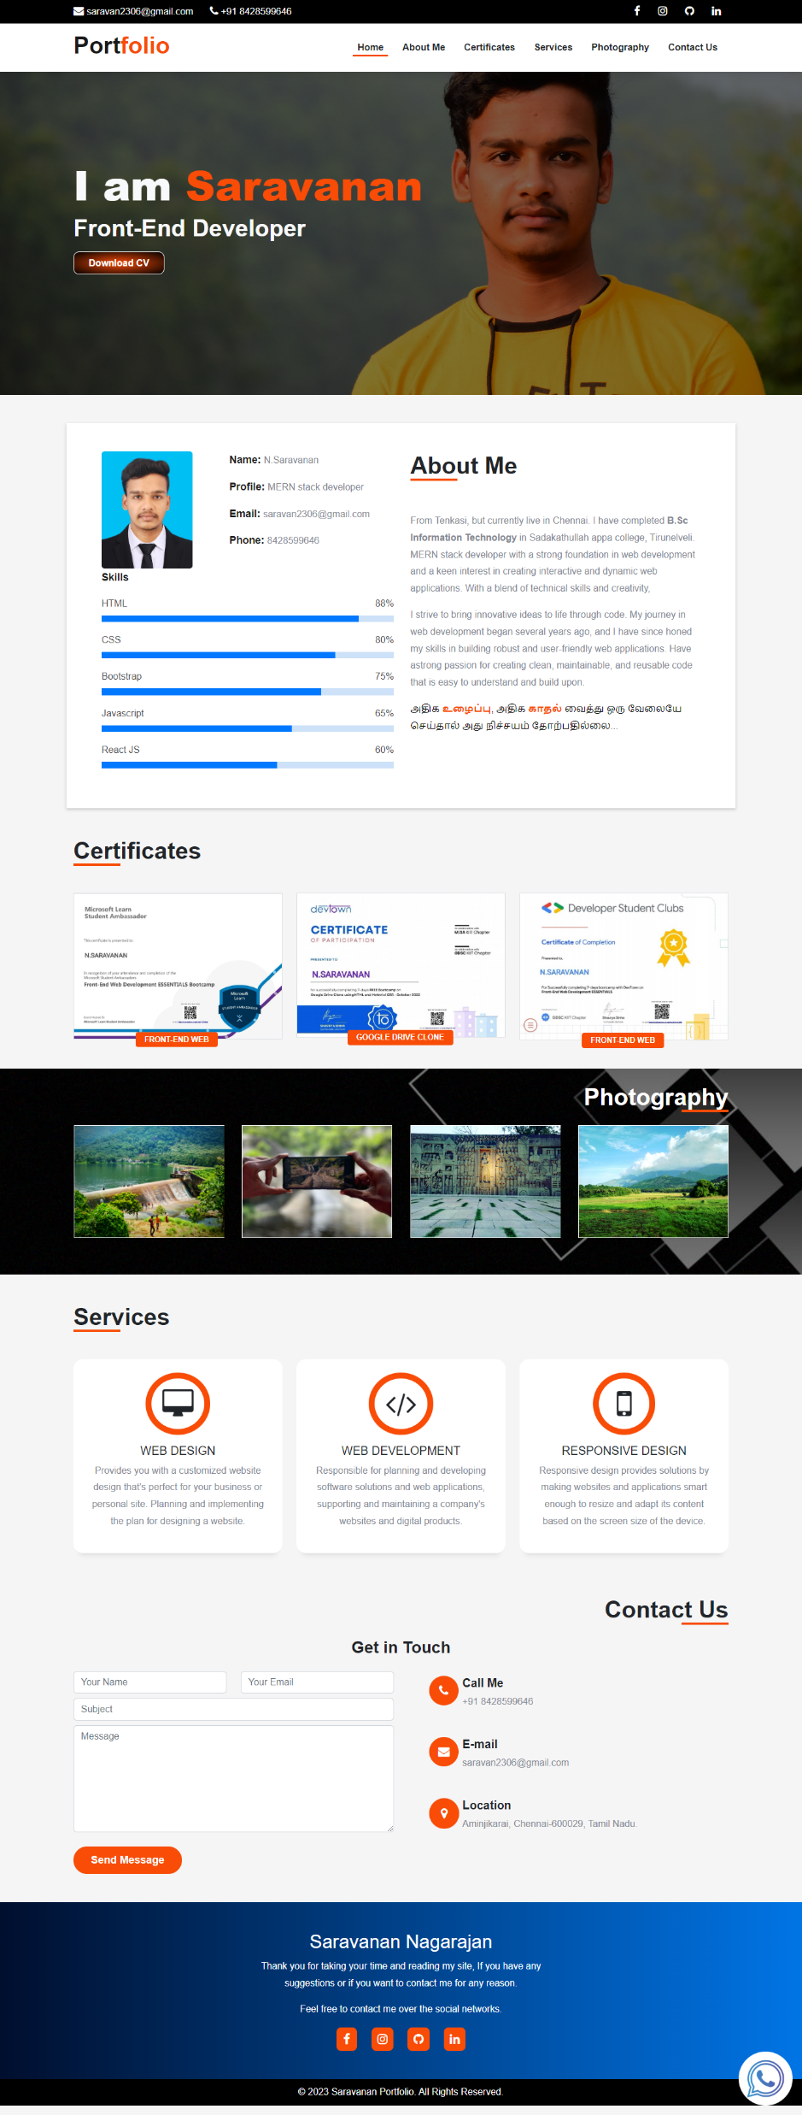
USER INTERFACE:
Optimizing the user interface to ensure fast loading times and smooth interactions. This may involve techniques like image optimization, code minification, and caching. Using PHP, we simplified the menu structure to ensure ease of navigation and improved user flow.

Slide 10
CONCLUSION:
A big thank you for entrusting me with this project. Remember, your digital presence is a dynamic asset. Stay connected, keep evolving, and let your portfolio be a testament to your passion and expertise.
Thank You…

